Slide 1
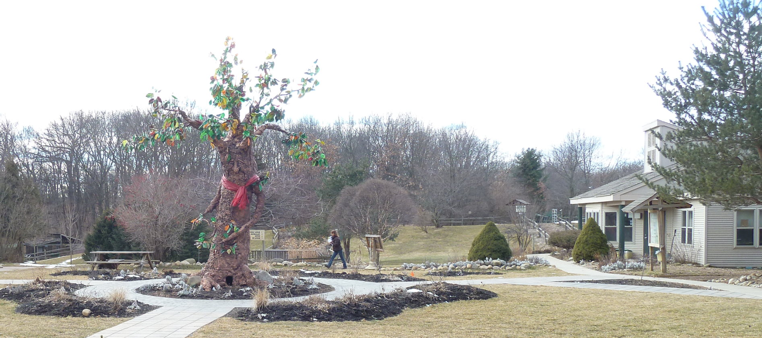

Swajan-Raptors’
Newsletter, Vol. 3
Howell Nature Center
February 18th 2012

Slide 2
Our objective
The third community event was at Howell Conference & Nature Center, Howell. Howell Conference & Nature Center is a non-profit organization funded primarily through private donations, programs, and special events. They provide care for injured and orphaned wild birds and mammals, and much more.
http://howellnaturecenter.org/
We donated lots of things from their current wish list of items for their wildlife infirmary. The items that we donated were Gloves, Receiving blankets, Towels, unscented dish detergent, Paper Towels, Unscented Laundry detergents, Dog dishes, Wild bird seed, Facial Tissue & Newspapers .

Slide 3
Our activities
The raptors of this community service were Aarushi, Abhishek, Ankita, Arnav, Ashna, Mihika, Neha, Nisha, Praneeth, Sumer, Anishka, Ayush, and Ashmit.
First we gathered all our donations and gave it to the people at the center.
Then we went to a special building to learn about the many different behaviors and specialized characteristics of a number of birds of prey.
A trained bird handler presented live birds of prey in this informative program. Sumer, Abhishek, Ayush and Arnav will give you some info about these birds.

Slide 4
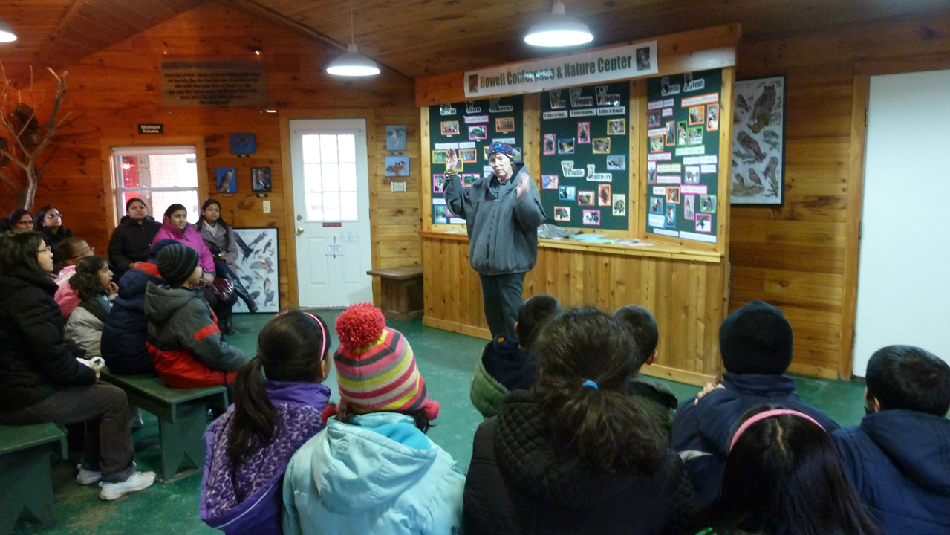
Learning about Birds of prey

Slide 5
Eastern Screech Owl
The Eastern screech owl at the Howell Nature Center has a body length of 9 inches.
It eats dead mice, but in their natural habitat they feed on insects, earthworms, small birds and mammals.
The owl is 5 years old. When they got it, it was an year old and it had an eye injury with a split in the side of the iris.
This small owl has about an 18 inch wingspan.
The owl has 14 vertebrae in its back.
Its personality trades are big eyes and ears in an opposite location.
The Eastern screech owls are common in Michigan with two colors gray and red, the one we saw had red feathers.

Slide 6
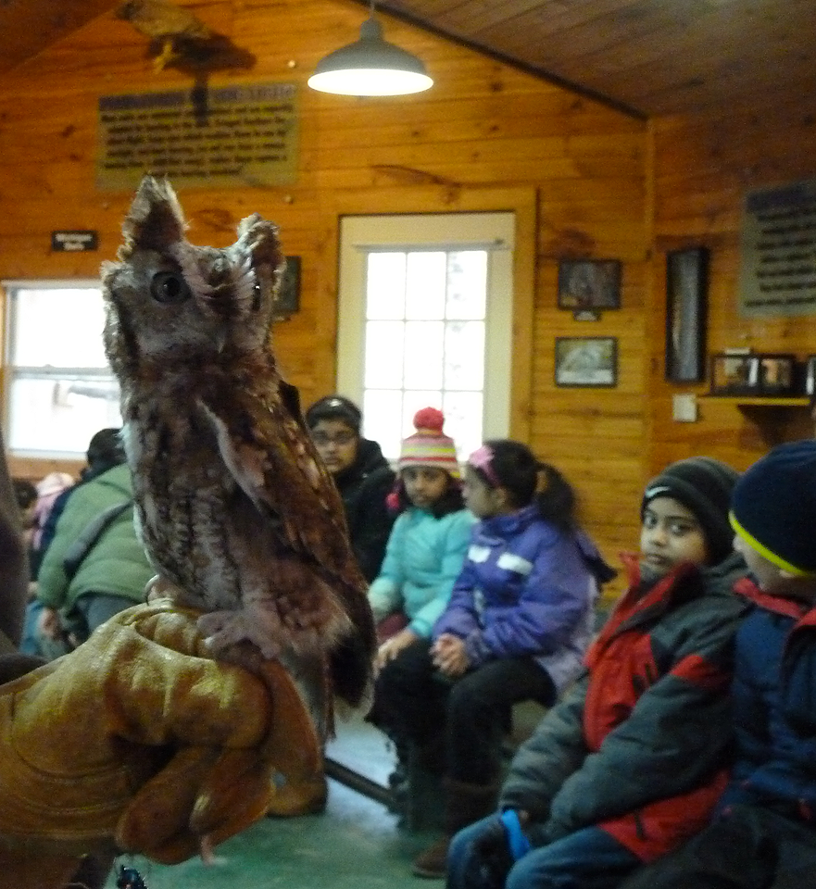
Eastern Screech Owl
By Sumer

Slide 7
Great Horned Owl
The Great Horned Owl is 24 years old and weighs 3lbs.
The owl had a neck injury. Generally these owls can turn around almost 270 degrees.
It is a carnivore and the male is smaller than the female.
The body span of this owl is 18 inches and around 1 meter of wingspan.
The owl’s left wing is smaller than its right wing so, it can’t fly too high.
The general lifespan of these owls are 12-15 years in their natural habitat, but they live longer in captivity.
This owl feeds on dead rats and mice donated from a rat/mice breeding farm in Kalamazoo, MI.

Slide 8
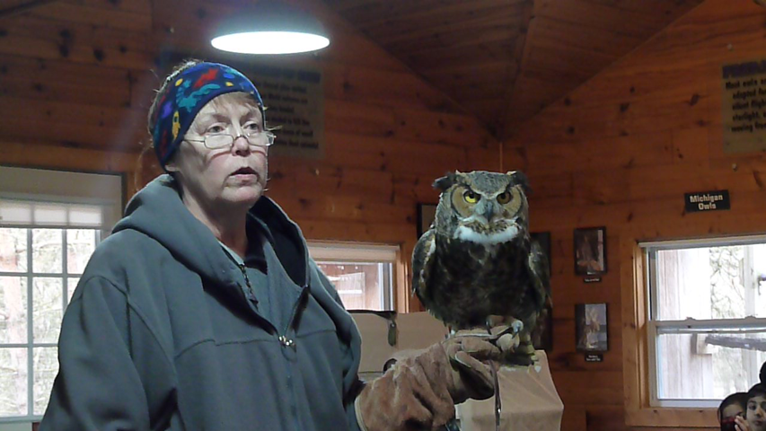
Great Horned Owl continues
By Sumer

Slide 9
All About Turkey Vultures ……
Turkey Vulture we saw is about 28-30 inches long with a wing span of around six feet. This Turkey Vulture weighs about four pounds.
Its head is bald because when it is sticking its head inside the carcass, none of the bacteria or the gross food would stick to it.
Genders appear identical and we don’t know the gender of this turkey vulture. This vulture only utter hisses or grunts. They hiss when they are threatened.
This bird of prey eats dead mice and rats that they feed.
  It flies with its wings in a V-shape. The Turkey Vulture we saw had a injured wing when they got it and the owner couldn’t take care of it.
We have a lot of Turkey vultures in USA and Canada; and in Michigan as well. They vomit to scare away predators. Once this bird ran away but it came back after two months and it loves being with people, but they lured him with a dead mouse on a fishing line.

Slide 10
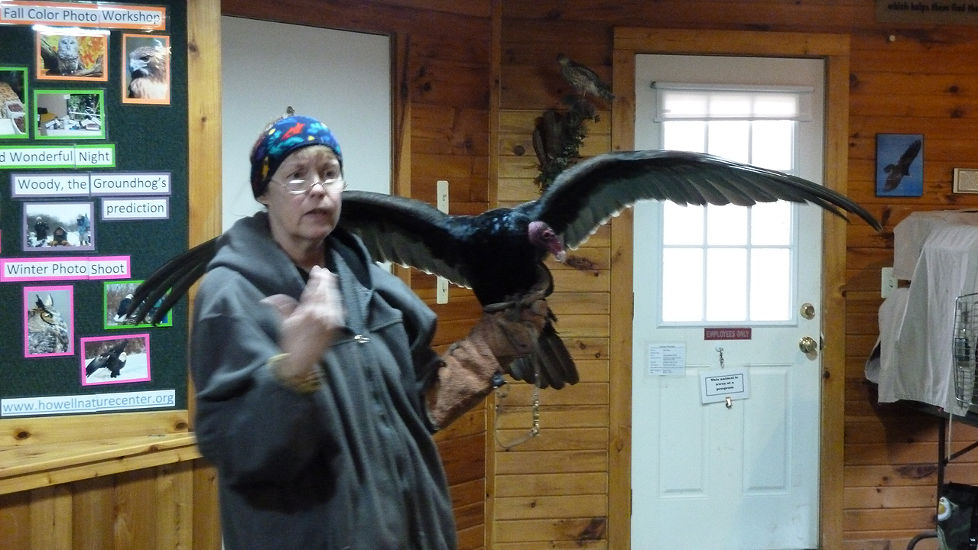
The Turkey Vulture that we saw . . .
By Abhishek

Slide 11
Peregrine Falcon
The 3 lbs. blue peregrine falcon we saw was injured in the wing. So it has a lot of predators for which it has not been released in the wild. This falcon has sharp talons and a sharp beak. He has 5 feet wing span. He eats dead mice.
The peregrine falcon is an endangered species. A healthy peregrine falcon can have no predators. They are fast hunters, can go 200 miles per hour when they swoop down for prey. The peregrine falcon has excellent eyesight, can see a prey from 5 miles away.
A natural habitat for peregrine falcons is high cliffs. So sometimes these birds are raised in a Nature Reserve and then released in big cities. They make nests in the skyscrapers and help kill mice in the big cities.
Finally, another interesting feature about peregrine falcon is that the female falcon weighs more than a male falcon.

Slide 12
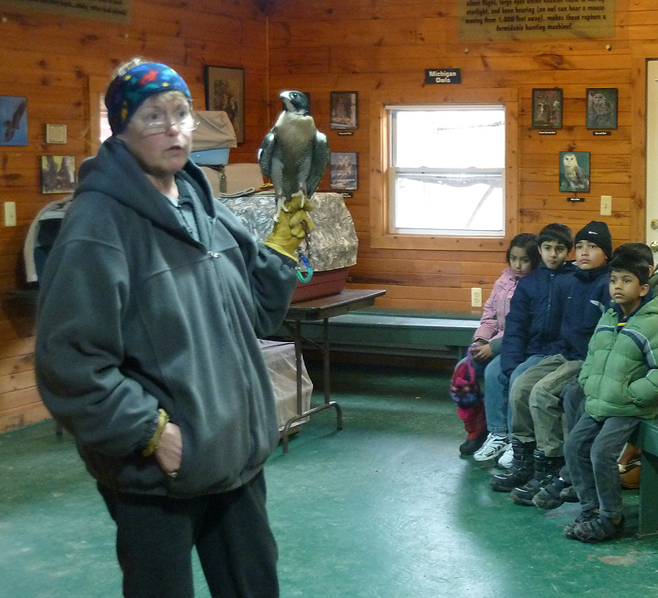
Peregrine Falcon continues….
By Ayush

Slide 13
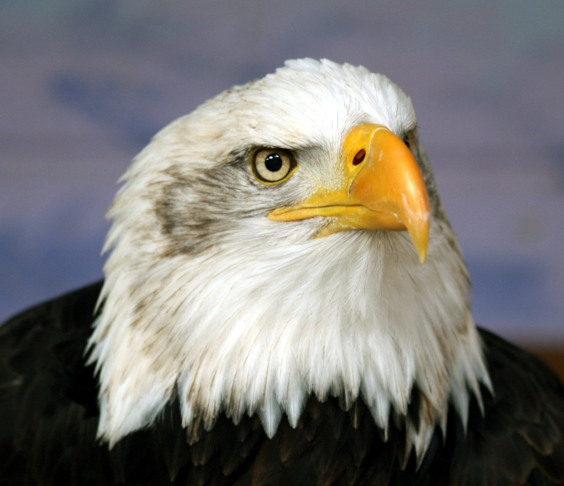
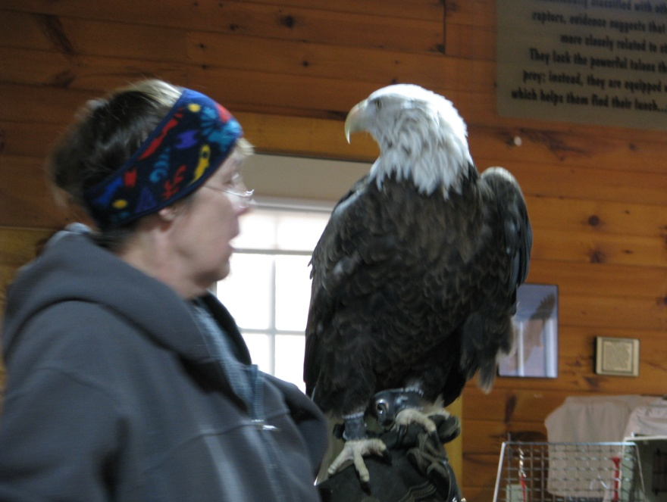
Bald Eagle
Lastly we saw a Bald Eagle our country’s national bird. The bird we saw couldn’t fly well. We learned that females are bigger than males. The Bald Eagle was the biggest bird we saw. They hunt for their food but can be scavengers. They are one of the two types of eagles in the U.S.
By Arnav
Click here to hear a Bald Eagle

Slide 14


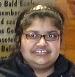
The Favorites of the Howell Nature Center
I liked learning about the birds and adopting one. I also liked seeing the other animals.
I liked learning about the eagle the best.
I liked watching the presentation.

Slide 15

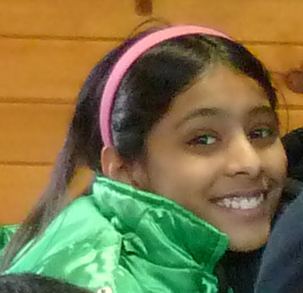

I liked adopting the owls.
I liked learning about the birds and looking at the animals.
I liked looking at all of the animals on the path.

Slide 16
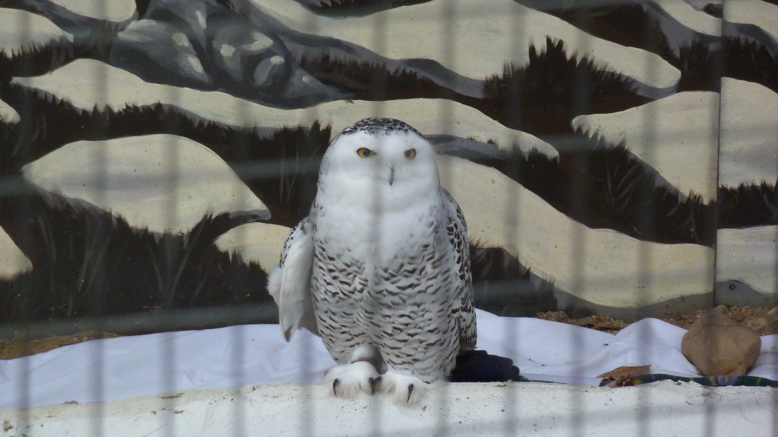
Raptors adopted this cute snowy owl…

Slide 17
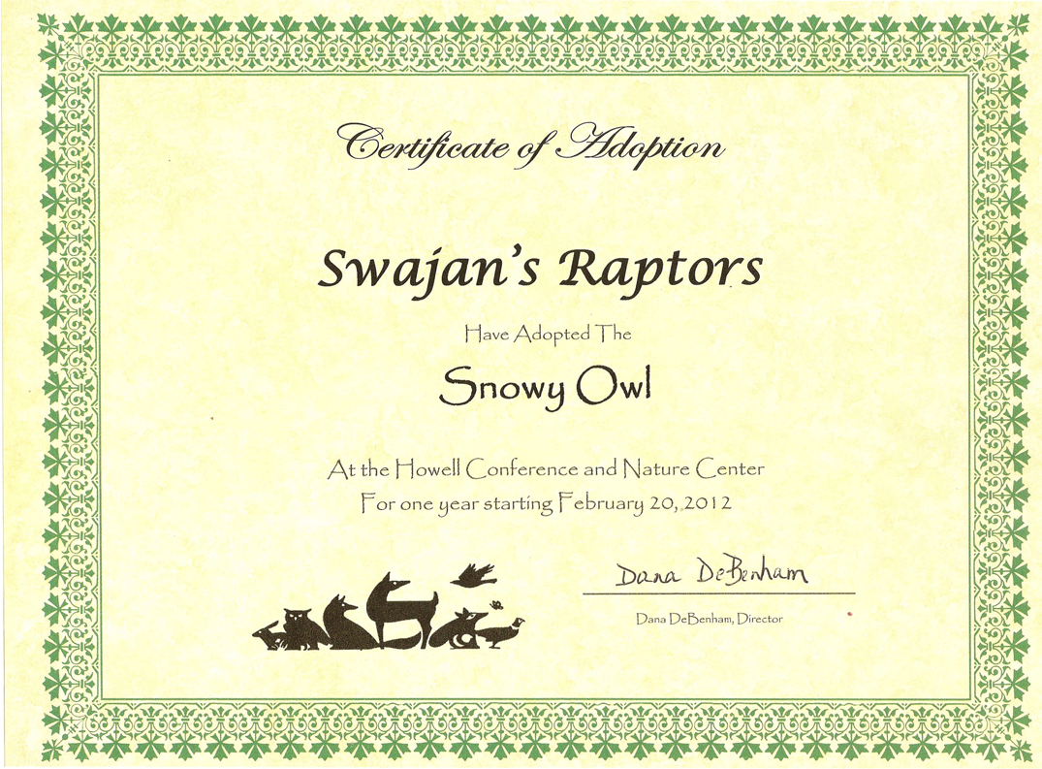
Certificate of Adoption

Slide 18
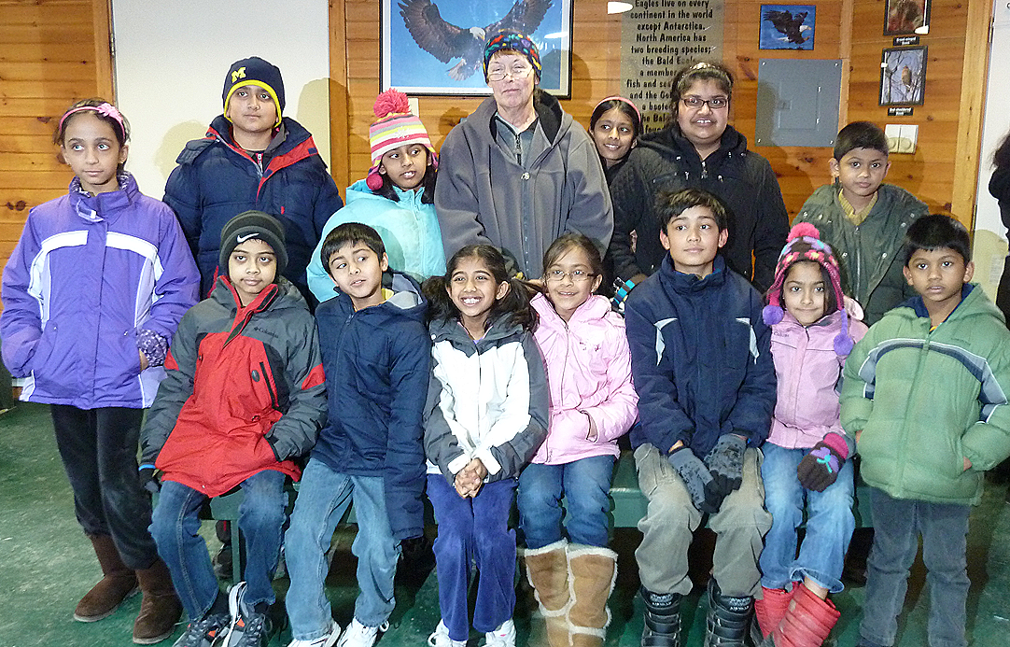
and Happy Raptors ….

Slide 19

Thanks to all our parents who drove us to Howell…..
Thanks for this great opportunity, we really loved it! Presented by Sumer, Abishek,Ayush, and Arnav.

