Slide 1
Swajan’s Raptors
The University of Michigan Cancer Center
Newletter-5
Friday, April 13th, 2012
Compiled by Nisha, Shibangi, and Neha

Slide 2
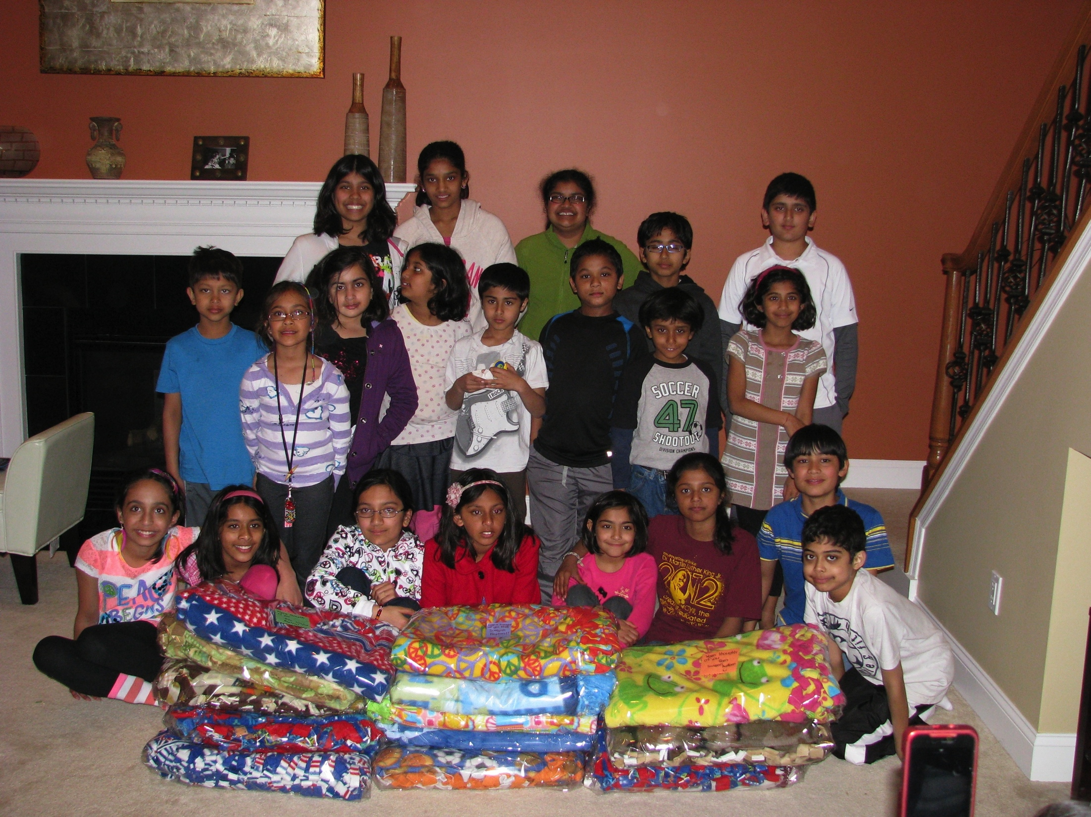
What we did:
We made blankets for the University of Michigan Cancer Center patients.

Slide 3
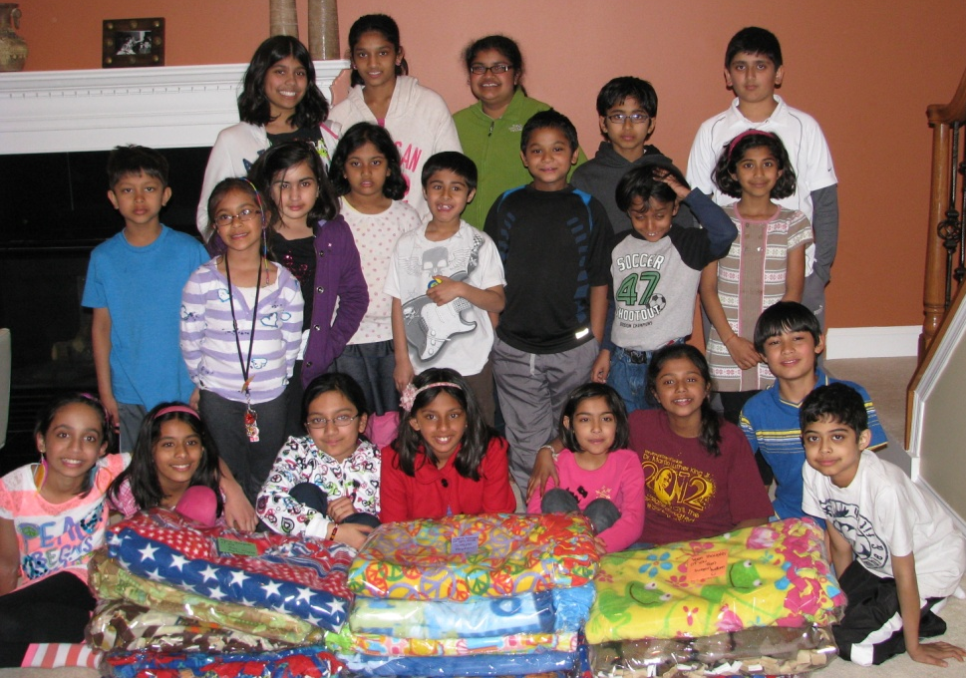
Participants
The Raptors present for this project were: Ashna, Mihika, Swagata, Tia, Praneeth, Anish, Rigu, Sumer, Arnav, Ankita, Aarushi, Anishka, Shibangi, Abhishek, Isha, Diya, Ankush, Neha, Nisha and we had two guests who were Gagana Borra and Pranav.

Slide 4
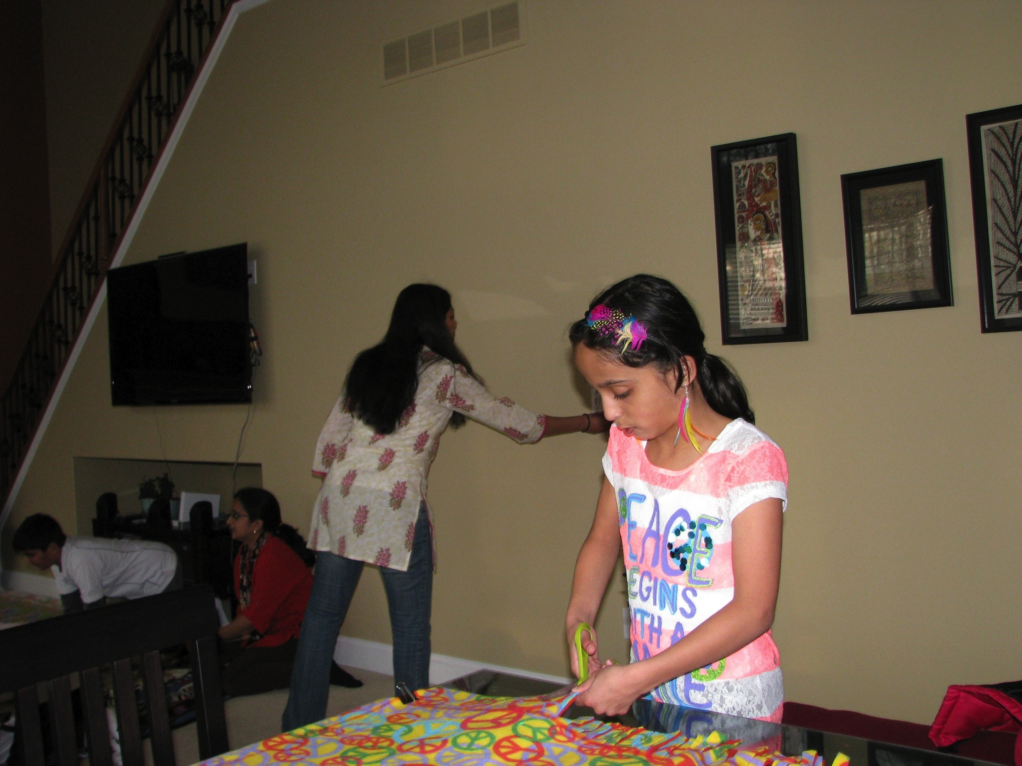
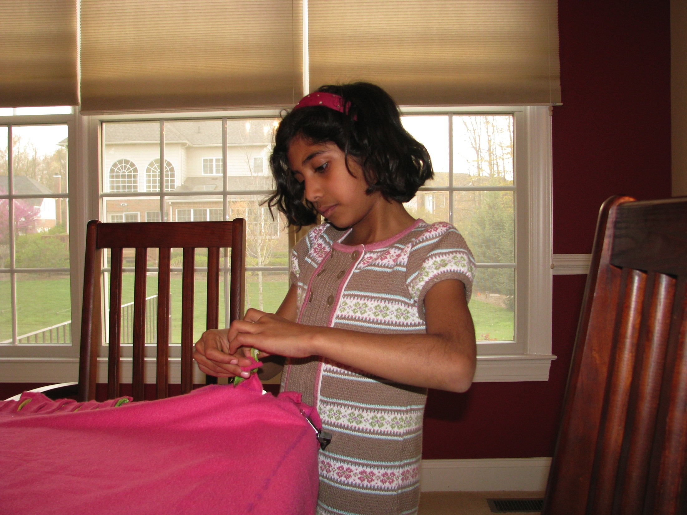
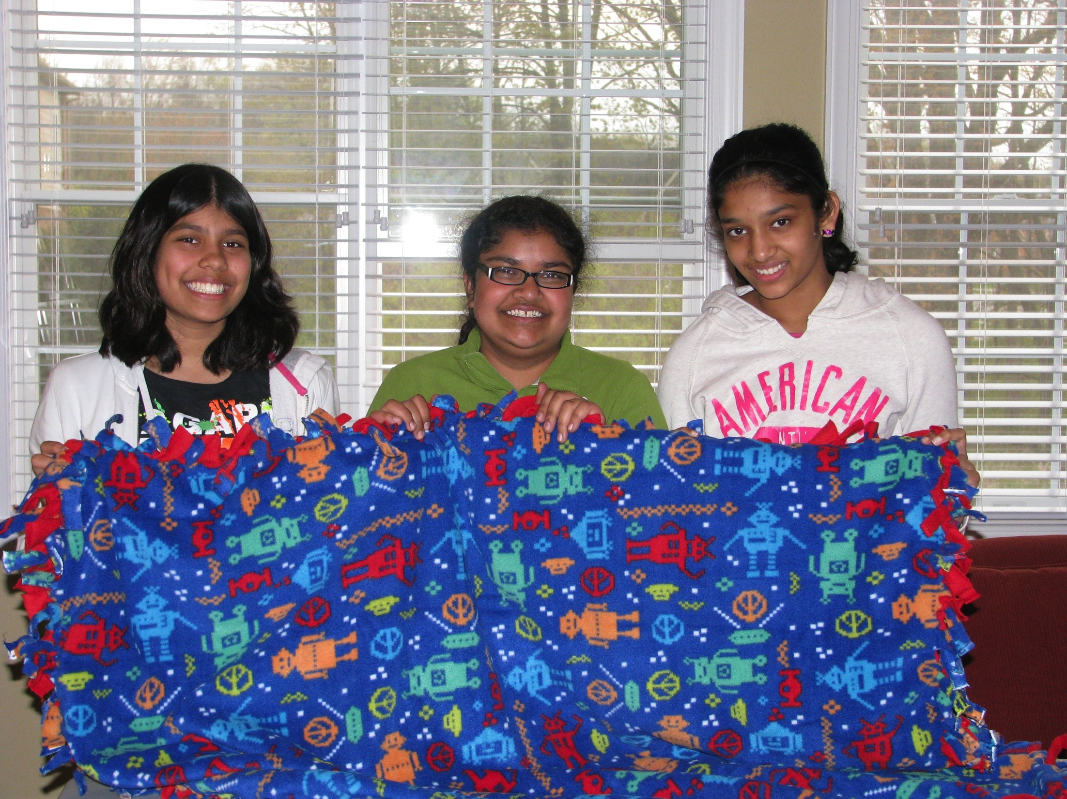

How did we do it?
We took two pieces of fleece and we cut four corner squares from each end. Then we drew a line on each side of the blanket. Afterwards, we cut 4” by 1” strips and we tied the strips together. Lastly, we wrapped them!!!

Slide 5
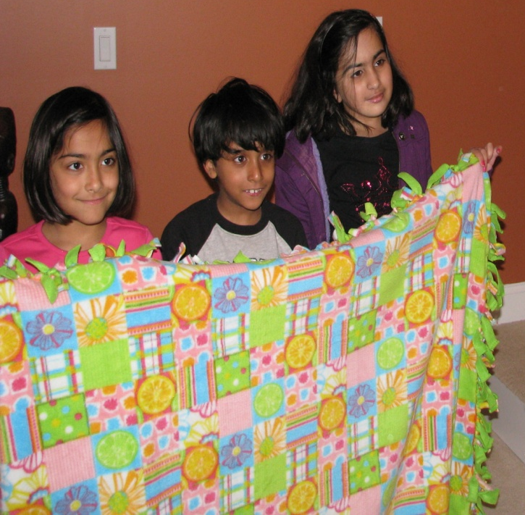
My Favorite Part:
Ashna: I like making fleece blankets.
Mihika : I like knotting the fleece blankets.
Swagata : I liked working together as a team to make the blankets.
Tia : I liked working with my friends.
Praneeth : I just want to help the cancer patients.

Slide 6
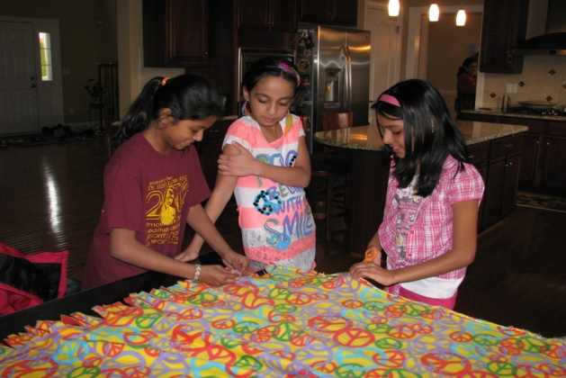
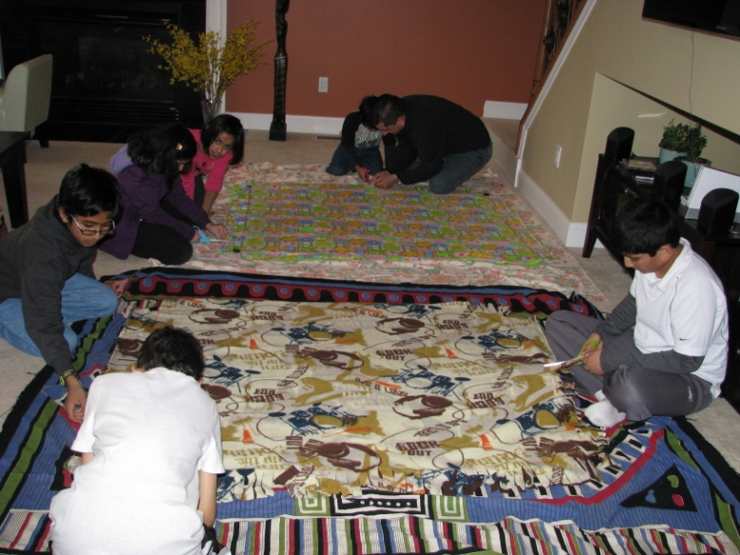
Thoughts
Riju: I like knotting the fleece blankets.
Arnav: I liked making blankets.
Sumer: I liked cutting and tying the blankets.
Pranav*: I liked it because it was helping people.
Ankita: I liked cutting and tying the blankets.
* Our Special Guest!

Slide 7
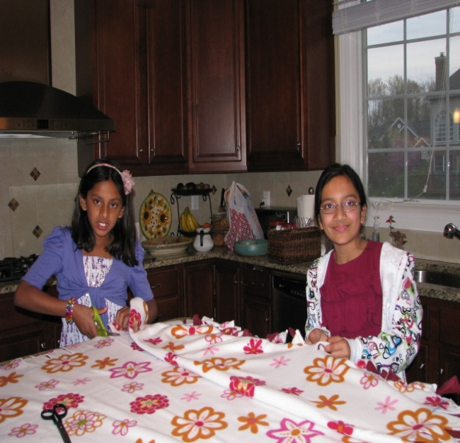
Work in Progress
Aarushi: I like cutting and tying and looking at the designs. I liked helping out people in need and making a difference.
Anishka: I liked making blankets.
Sharmi: I liked to help out people in need and make a big difference.
Gagana*: I liked cutting blankets.
*Our other special guest

Slide 8
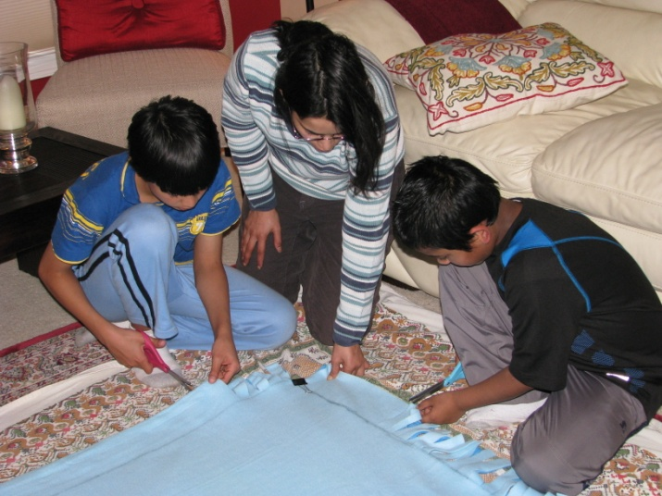
Cutting Business
Abhishek: I liked cutting the blankets.
Isha: I enjoyed making the blankets and hope that the cancer patients enjoy them too.
Diya: I LOVED looking at the different designs of the blankets and knowing we were helping people.

Slide 9
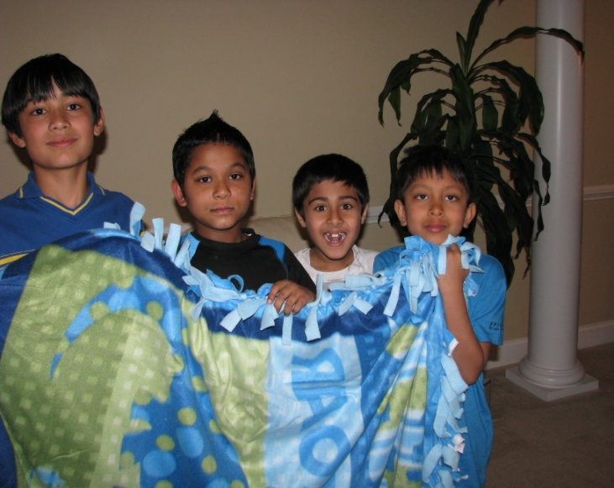
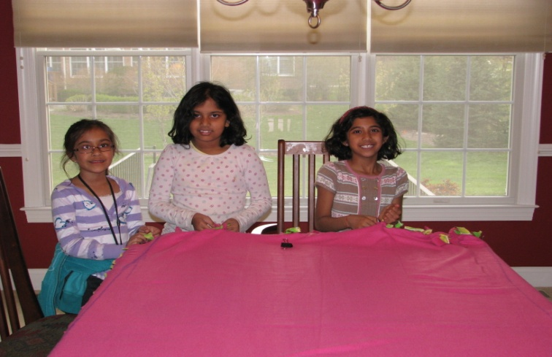
Cutting & Holding
Ankush: I liked making blankets.
Nisha :I liked helping people in need.
Neha: I enjoyed helping the cancer patients.

Slide 10
“Thank You”
We would like to thank all the parents that help support the project, without you this project would not be successful. We really appreciate it!!!

Slide 11
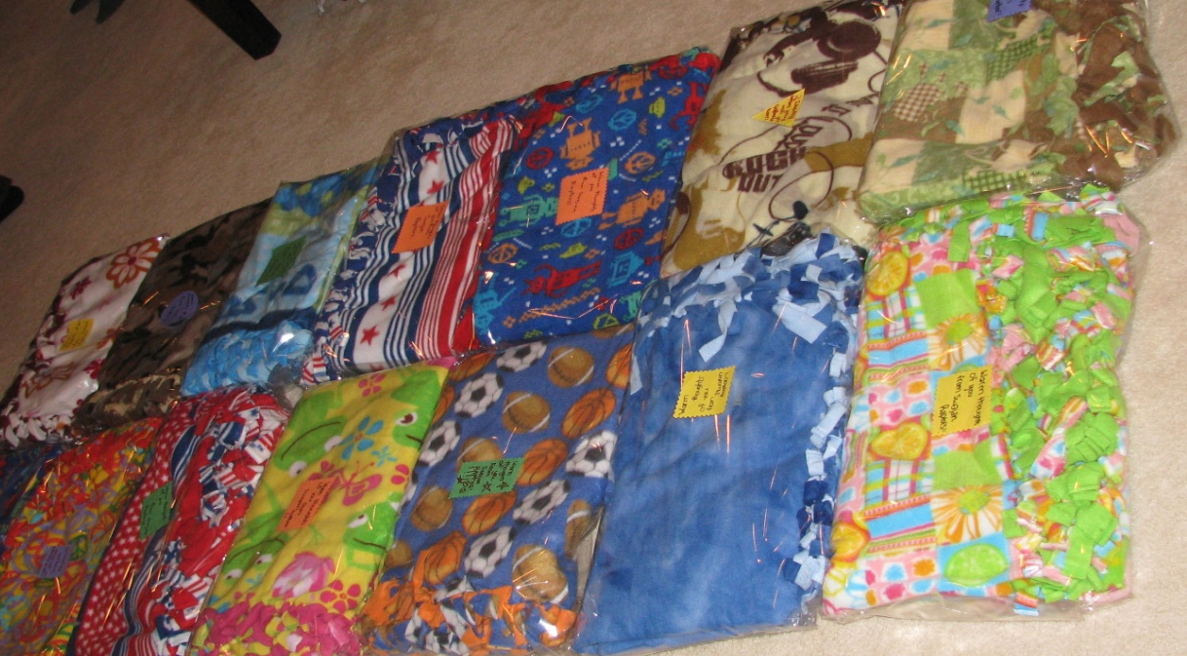
Thank you
Thank you so much for reading our presentation!!! We really appreciate it!!! We hope that you enjoyed it!!!

