Slide 1
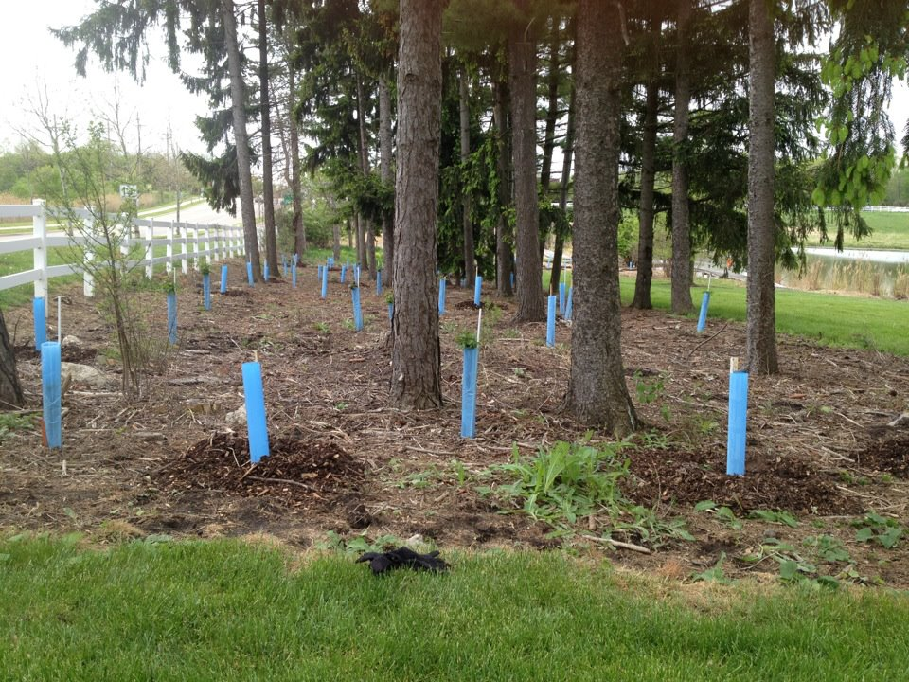

Celebrating Earth Day at MSU
Tollgate Farm
EARTH DAY:
May 5, 2012
Swajan Raptors
Presentation Made By:
Isha Ghosh, Riju Ghosh, and Praneeth Dattagupta

Slide 2
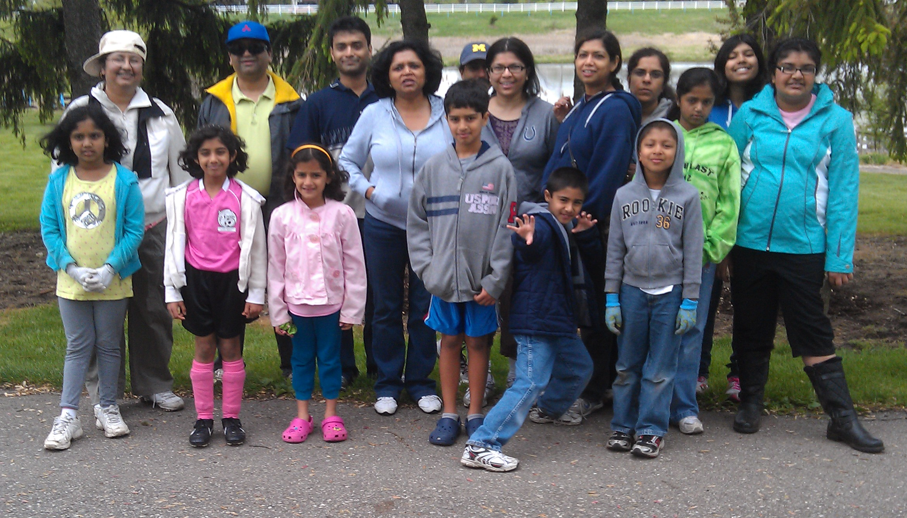
The Participants
(From Left) Tia, Ashna, Ashna’s Friend and Brother, Praneeth, Riju, Diya, Isha, Neha, and parents
(Not in Picture) Arnav

Slide 3
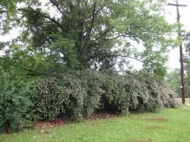
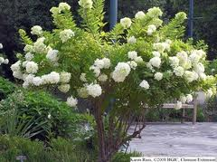
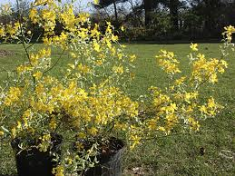
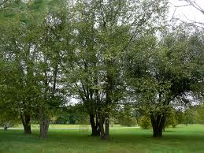
Trees We Planted
Beauty Bush
Compact Peegee Hydrangea
Golden Guinea Kerria
River Birch

Slide 4


How We Planted The Trees
First, we dug a hole (not too deep) and placed the plant inside, making sure that the roots went straight in, and not curled.
We then covered up the hole and hammered in a stake beside the plant.
The plant, along with the stake, were covered by two blue, plastic wraps.
Lastly, we surrounded the plant with mulch.

Slide 5
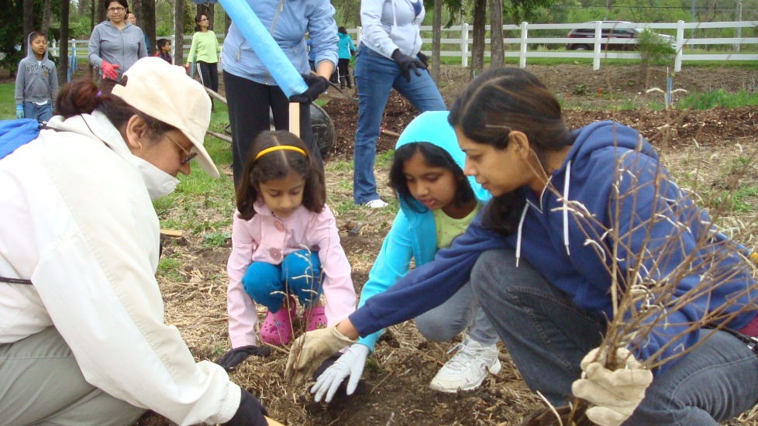
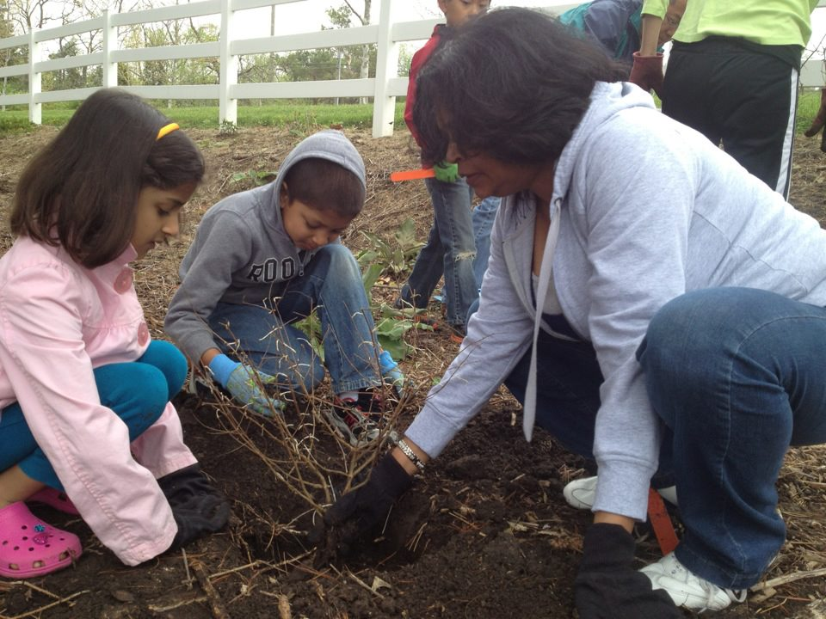
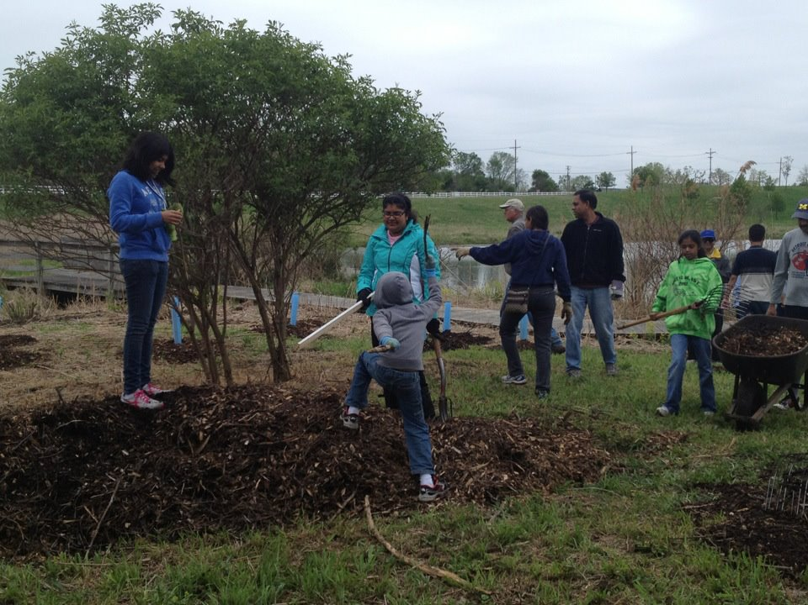
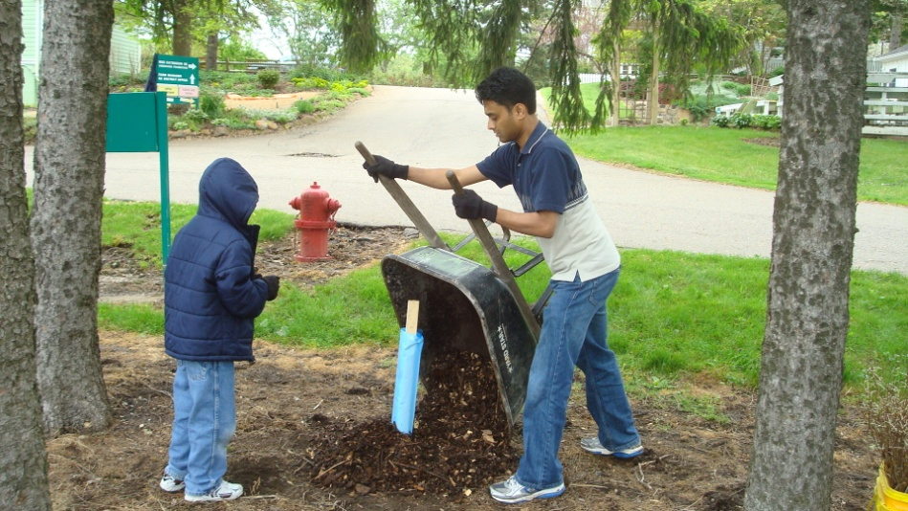

Slide 6
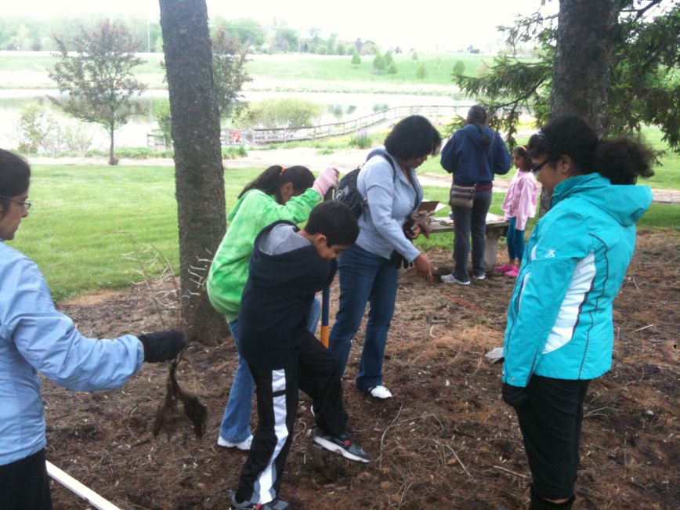
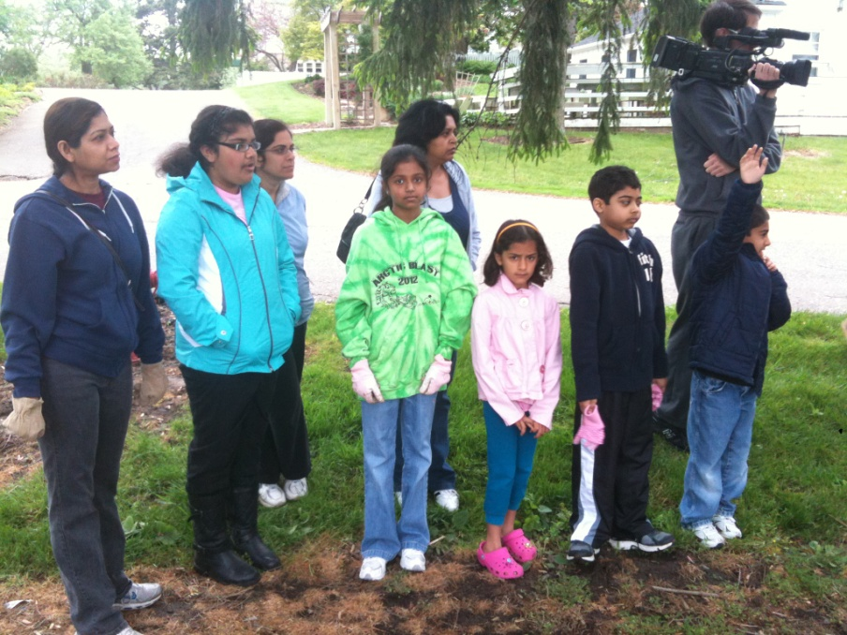
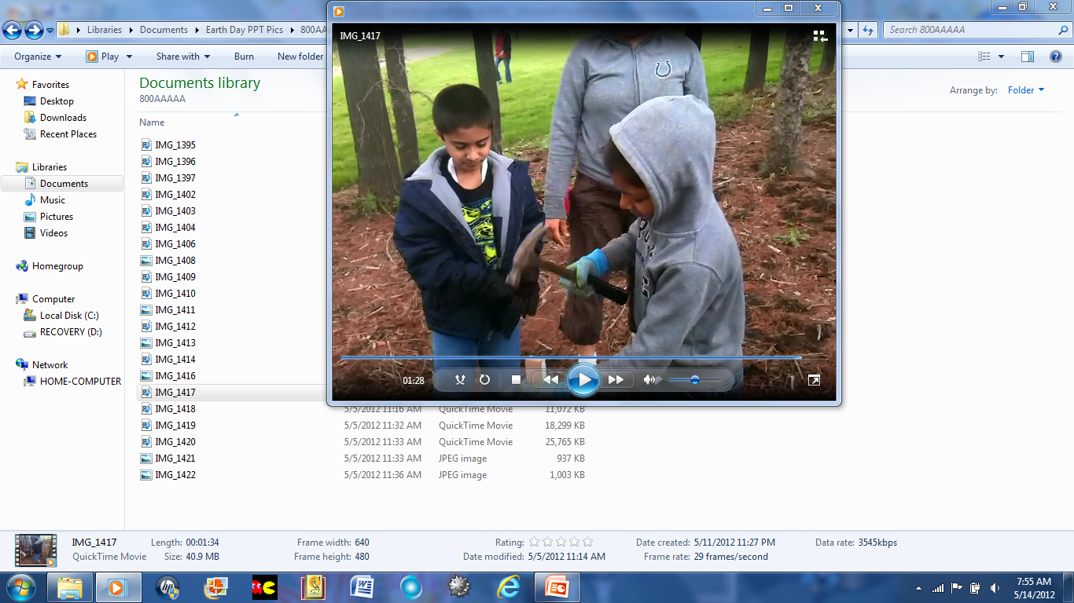
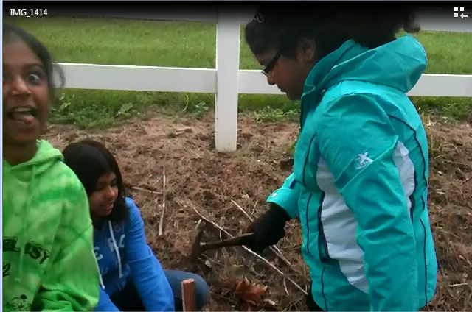

Slide 7
What We Liked
Diya: “I liked digging the soil, planting the trees and helping the Earth”
Isha: “It was fun, and helpful to plant trees”
Praneeth: “I just liked saving the Earth”
Neha: “It was fun to plant trees”
Riju: “I liked to plant the trees, and digging up and dumping the mulch”
Arnav: “I like planting trees and saving the planet”
Tia: “Every small step taken now, will help to create a better future ahead”

Slide 8

We planted more than TWENTY trees!! Great job Swajan Raptors!!!

Slide 9

Thanks goes to all the parents who helped make this project possible. THANK YOU!!

Slide 10

THANK YOU

